Slide 1
OIS 6660
Adam Tidwell
10/11/14

Slide 2

Agenda
Quiz
Discussion
Project Time Management
Key terms
Precedence diagraming
Sequence activities
Activity resources
Estimate activity durations
Scheduling terms
Gantt charts
Class activity: MS Project
Group project
Timeline
CAPM/PMP Preparation

Slide 3

Quiz 3
On Canvas
25 minutes
Closed book/internet

Slide 4
Discussion
PMBOK: Chapter 6

Slide 5
Project Time Management
Notes:
More (time) tools in the project management toolbox.

Slide 6
Milestones
Start
Financial systems in place
Construction complete
Move in complete
Finish
Notes:
Zero duration
Indicate significant events on the project timeline
Concept of milestone is very important – read for quiz

Slide 7

Rolling Wave Planning
Notes:
Plan things that will happen sooner in more detail
For things in the future, plan with fewer details
Project can be planned properly for a month but beyond that it gets little difficult and people overwhelm.

Slide 8
Precedence Diagraming
Squares represent the activities
Arrows indicate dependencies
Numbers in boxes indicate the activity's duration
Notes:
Activity:
Create a simple precedence diagram.
Precedence diagram - Helps with the flow. Like what comes first.

Slide 9
Dependencies
Most common is Finish to Start
Start to Finish rarely used
Notes:
Demonstrate examples of dependencies.
Activity:
Create precedence diagram with dependencies.
Finish to start is default.
Start to finish is very rare.
Have an example of each one in your head for the quiz.

Slide 10
Sequence Activities
Lead- time an activity can start sooner than its dependency
Lag- time an activity will start later than its dependency
Notes:
Lead
Task A: fill rocket tanks to go to the moon
Task B: launch rocket to the moon
Lead time- must fill the tanks 3 days before launch
Lag
Task A: launch rocket to the moon
Task B: switch to oxygen tank #2
Lag time- Will need new oxygen 2 days after launch
Have an example of each in your head for the quiz

Slide 11
Estimate Activity Resources
Those who do the work know how to estimate durations best
Resources are people, material, equipment, supplies, systems
Bottom-up estimating
Notes:
Resources are more than people.

Slide 12
Estimating Activity Durations Techniques
Analogous Estimating- using a previous project to estimate
Parametric Estimating- Using cost per hour and historical data
Three Point Estimating (PERT)- tE=(tO+4tM+tP)/6
Notes:
Analogous- less time, less accurate, historical data (and expert judgment), similar to another project. Like building a similar databases.
Parametric- quantity of work x labor hours per unit of work, price per square foot. Like checking for house prices on zillow.
3 point estimating (PERT, Program Evaluation & Review Technique)- next slide.

Slide 13
PERT
Weighted average of 3 different estimates to determine the activity duration.
Estimate = (P + 4M + O)
6
P = pessimistic estimate
M = likely estimate
O = optimistic estimate
Notes:
Accounts for risk and uncertainty.
Helps you overestimate. Applies little science in estimation. Helps mitigating the opportunity cost.

Slide 14
Critical Path
Longest path (minimum project duration)
Slack (float)- how long an activity could be delayed with impacting the critical path (overall project)
Critical path does not have slack
Notes:
Examples
Longest path is the critical path.

Slide 15
Calculating Total Float
Calculate duration for each path
Determine the critical path
Total Float= critical path – length of non-critical path
Notes:
Examples
There is no difference between float and slack.

Slide 16
Scheduling Terms
Crashing- providing more money to get done sooner (OT, additional resources, expedited delivery, etc.)
Fast Tracking- doing things at the same time to speed up completion of the project
Critical Chain- adds buffers to each activity to account for resource availability (vacations, etc.), usually makes critical path longer
Resource Leveling- start and finish dates are adjusted due to resource constraints
Notes:
Resource leveling – moving things to do when free.

Slide 17
Gantt Charts
Used for planning, not reporting!

Slide 18
Class Activity
MS Project

Slide 19
Microsoft Project
Tasks
Manual vs. automatic scheduling
Linking
Predecessor/dependencies
Outlining
Resources
Gantt chart
Task leveling

Slide 20
Group Project
Create MS Project file
Complete project timeline

Slide 21
Project Timeline
At least 30 tasks with appropriate summary tasks
Must contain logical linkages and task durations
Must have resources assigned to each task
Must be well organized with a clear structure

Slide 22
Preparing for the PMP/CAPM Exam

Slide 23
Homework report: Share
Mnemonic
Other ideas

Slide 24
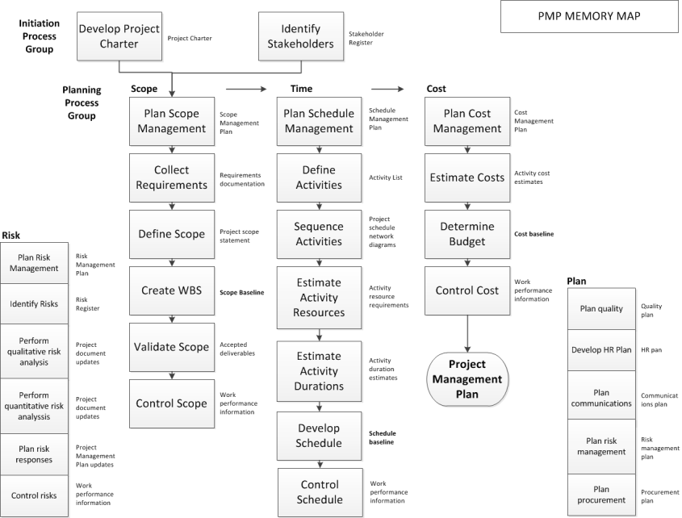

Slide 25
What else should I be doing?
Study practice tests available online
At least 50 per week
Time the questions so you can do 50 in an hour
Research why you missed the question
Memorize the PMP Memory Map
Read and highlight the book (PMBOK 5th Edition or other)

